Slide 1
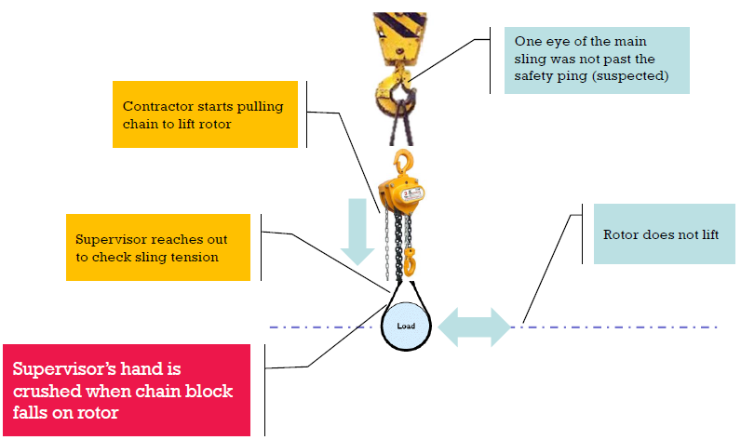
HS&E INCIDENT BULLETIN |  | 2nd half year 2015
Abu Dhabi Island, United Arab Emirates | Type of incident Pinch point / caught between and struck by
Summary:
During a bearing lift check on a Compressor (Non Drive End Side), a 3 Ton Chain Block being used to lift the compressor shaft fell off the overhead crane and struck and injured the left hand. The hand was on the compressor rotor at the time of the incident.
Root Causes: | Actions Taken Thus Far: Next Steps
Insufficient Risk assessment Lack of Control during work execution Inadequate Communication Competence/Training |  | -Clear roles and responsibilities before starting work. -Lift planning and Risk Assessment. -Check and ensure the skills, the competences and experiences of the assigned to the task. -Ensure the proper management of lifting, establishing clear roles and communication lines.

